Slide 1
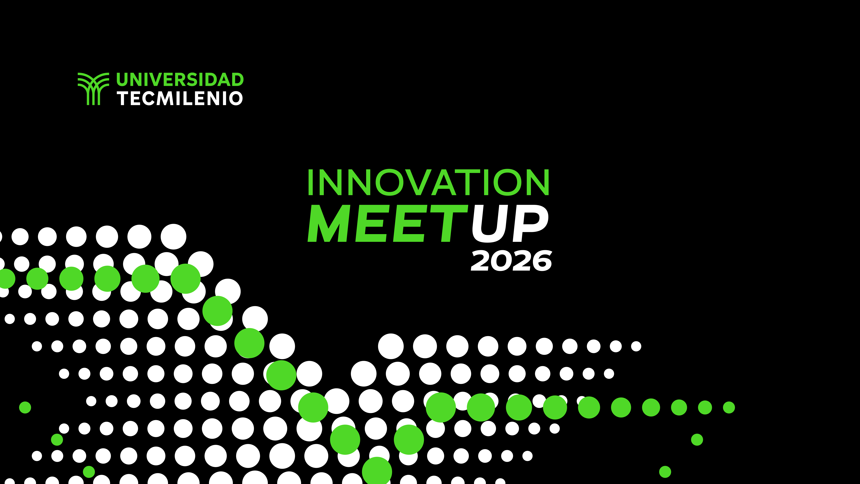

Slide 2
KIA México: Digital Paint Shop

Slide 4
Objetivo del reto
Diseñar una solución innovadora, basada en conceptos de Industria 4.0 (como inteligencia artificial, gemelos digitales y analítica de datos), que permita que al menos el 80% de los parámetros críticos del Paint Shop en KIA México estén digitalmente conectados, monitoreados y optimizados, considerando las restricciones reales de operación y presupuesto de la planta.
IMPORTANTE: Esta diapositiva se incluye únicamente como referencia y debe eliminarse/ocultarse en la entrega y en la presentación final.

Slide 5
Entregables esperados
Propuesta técnica
Propuesta financiera
Plan de implementación
​​
Más detalles en documento "Hoja de definición del reto“ y la “Rúbrica de evaluación del reto”
IMPORTANTE: Esta diapositiva se incluye únicamente como referencia y debe eliminarse/ocultarse en la entrega y en la presentación final.

Slide 6
Aspectos a evaluar:
Uso de conceptos de Industria 4.0 (20%)
Conectividad y optimización de procesos (20%)
Cumplimiento de restricciones y presupuesto (15%)
Indicadores de éxito y medición (10%)
Propuesta técnica y viabilidad (10%)
Plan de implementación (10%)
Innovación y creatividad (5%)
Uso de Inteligencia Artificial (5%)
Presentación (5%)
Más detalles en documento "Rúbrica de Evaluación"
IMPORTANTE: Esta diapositiva se incluye únicamente como referencia y debe eliminarse/ocultarse en la entrega y en la presentación final.

Slide 7
Team members
Content (for each team member):
Full name
Academic program
Campus
Photo

Slide 8
Use of Industry 4.0 Concepts (20%)
Content:
Brief description of the Paint Shop process and its complexity
Key Industry 4.0 concepts used in the proposal:
Artificial Intelligence
Data analytics
Industrial connectivity
Digital platforms or digital twins (if applicable)
Why these technologies are relevant for the Paint Shop
How they support digitalization and decision-making

Slide 9
Connectivity and Process Optimization (20%)
Content:
Critical process parameters to be digitalized
How parameters are currently managed (high-level)
How data will be captured and connected
Data flow and system integration
How the solution enables:
Real-time or near real-time monitoring
Process optimization
Reduction of variability or defects

Slide 10
Compliance with Constraints and Budget (15%)
Content:
Operational constraints considered:
Two technical shutdowns per year
Weekend-only interventions
Limited installation windows
Technological constraints in the Mexican plant
Budget considerations
How the proposal adapts to these constraints
Why the solution is realistic and viable

Slide 11
Success Indicators and Measurement (10%)
Content:
How progress toward 80% digitalization will be measured
Percentage of critical parameters digitally connected
Monitoring coverage across the Paint Shop process
Stability and consistency indicators of monitored parameters
Tools and dashboards used to track performance
Evidence used to verify improvement over time

Slide 12
Technical Proposal and Viability (10%)
Content:
High-level architecture of the solution
Main components (sensors, platforms, analytics, dashboards)
Data logic and processing
Compatibility with an automotive manufacturing environment
Why the solution is technically feasible for KIA Mexico

Slide 13
Implementation Plan (10%)
Content:
Phases of implementation
Activities aligned to:
Technical shutdowns
Weekend work
What is implemented in each phase
Timeline overview
Justification for the proposed sequence

Slide 14
Innovation and Creativity (5%)
Content:
Innovative aspects of the proposal
What makes the solution different from traditional approaches
Creative use of data, connectivity, or visualization
How innovation adds operational value

Slide 15
Use of Artificial Intelligence (5%)
Content:
Explain how and for what purpose artificial intelligence was used during the development of your proposal (e.g., ideation, research, text improvement, image creation, prototyping, or analysis)

Slide 16
Conclusion & benefits
Content:
Solution summary and core value
Key benefits and expected impact
Why this proposal should be considered
Strong closing message

